Slide 1
Flying High: A Review Analysis
of British Airways with User Reviews
PREDICTING CUSTOMER BUYING BEHAVIOUR

Slide 2
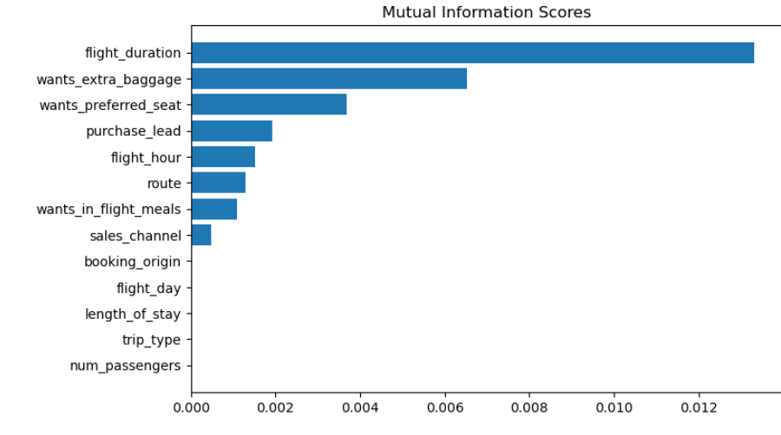
PREDICTIVE MODEL TO UNDERSTAND FACTORS THAT INFLUENCE BUYING BEHAVIOUR
We have train the Random forest Classifier model with data and received
ACCURACY: 85.09
AUC score: 0.5577796717361984
The Top 5 features which Influence Customer
Buying Behavior are :
Flight Duration
Wants extra baggage
Wants preferred seat
Purchase lead
Flight hour

